Slide 1
DP-601T00A: Implementing a Lakehouse with Microsoft Fabric
Notes:
Instructor notes and guidance.
This space has been left deliberately blank

Slide 2
About this course
In this course, you'll learn how to implement data lakehouses with Microsoft Fabric.
You will:
Understand the foundation of data engineering on Fabric through the exploration of the Lakehouse.
Explore the powerful capabilities of Apache Spark for distributed data processing.
Gain essential techniques for efficient data management, versioning, and reliability by working with Delta Lake tables.
Explore data ingestion and orchestration using Dataflows Gen2 and Data Factory pipelines.
Notes:
Instructor notes and guidance.
If students need to learn (or brush up on) basic data and analytics skills, recommend the following resources on Microsoft Learn:
https://learn.microsoft.com/training/paths/introduction-data-analytics-azure/
https://learn.microsoft.com/training/paths/azure-data-fundamentals-explore-data-warehouse-analytics/

Slide 3
Intended audience
The primary audience for this course is data professionals who are familiar with data modeling, extraction, and analytics. It is designed for professionals who are interested in gaining knowledge about Lakehouse architecture, the Microsoft Fabric platform, and how to enable end-to-end analytics using these technologies.
Notes:
Instructor notes and guidance.
If students need to learn (or brush up on) basic data and analytics skills, recommend the following resources on Microsoft Learn:
https://learn.microsoft.com/training/paths/introduction-data-analytics-azure/
https://learn.microsoft.com/training/paths/azure-data-fundamentals-explore-data-warehouse-analytics/

Slide 4
Course agenda
Introduction to end-to-end analytics using Microsoft Fabric
Get started with lakehouses in Microsoft Fabric
Use Apache Spark in Microsoft Fabric
Work with Delta Lake tables in Microsoft Fabric
Ingest Data with Dataflows Gen2 in Microsoft Fabric
Use Data Factory pipelines in Microsoft Fabric
Notes:
Link to Learning Path associated with this course: aka.ms/dp601
The bullets on the slide list the slide decks for this course with links to the corresponding learning paths on Microsoft Learn. The course is intended to be delivered in 1-day, or as a blended delivery over a longer period.
Be clear about the relationship between the slides in this classroom-based course and the associated learning paths on Microsoft Learn. The slide presentations are aligned to the learning paths, but do not necessarily map 1:1 with them. This enables you to provide an optimal learning experience within the constraints of a 1-day instructor-led class, while enabling students to use the supporting online modules to go deeper into some topics and reinforce what they learn during the class.
Each slide deck in this course ends with a “Further reading” slide that includes a link to the corresponding module on Microsoft Learn. Encourage students to use these online resources as reference materials in the same way a college student might use an assigned textbook to dive deeper into the core concepts covered in classroom lectures.

Slide 5
Hands-on exercises
This course includes hands-on exercises/labs to enable you to learn practical skills with the technologies.
Each exercise is standalone and requires:
A Microsoft 365 subscription with access to Microsoft Fabric. Microsoft Fabric must be enabled in the admin portal of the tenant and users must be working in a Fabric-enabled workspace.
Notes:
Set student expectations for the lab exercises. Microsoft Fabric is in preview, and as such, may be subject to frequent changes and occasional bugs.
All lab instructions can be found at: aka.ms/mslearn-fabric

Slide 6


Explore end-to-end analytics with Microsoft Fabric
Notes:
aka.ms/fabric-intro Before delivering this presentation, review the associated module on Microsoft Learn (https://aka.ms/fabric-intro).
The goal of this presentation is to provide a high-level introduction to end-to-end analytics on Microsoft Fabric. The presentation does not get into implementation-level details – it introduces the Fabric platform, discusses who Fabric is for, and explores Fabric services.
The estimated time to present these slides is 30 minutes.

Slide 7





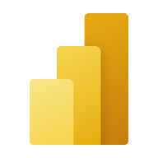


Microsoft Fabric
Data Integration
Data Engineering
Data Warehouse
Data Science
Real Time Analytics
Business Intelligence
Observability
Data Factory
Synapse
Synapse
Synapse
Synapse
Power BI
Data Activator
Data Factory: data integration combining Power Query with the scale of Azure Data Factory to move and transform data.
Synapse Data Engineering: data engineering with a Spark platform for data transformation at scale.
Synapse Data Warehouse: data warehousing with industry-leading SQL performance and scale to support data use.
Synapse Data Science: data science with Azure Machine Learning and Spark for model training and execution tracking in a scalable environment.
Synapse Real-Time Analytics: real-time analytics to query and analyze large volumes of data in real-time.
Power BI: business intelligence for translating data to decisions.
Data Activator: real-time detection and monitoring of data that can trigger notifications and actions when it finds specified patterns in data.
OneCopy is a key component of OneLake that allows you to read data from a single copy, without moving or duplicating data.
OneLake
UNIFIED
SaaS product experience
Security and governance
Compute and storage
Business model
Notes:
This is a build slide. Scalable analytics can be complex, fragmented, and expensive. With Microsoft Fabric, you don't have to spend all of your time combining various services from different vendors. Instead, you can use a single product that is easy to understand, set up, create, and manage. Fabric is a unified software-as-a-service (SaaS) offering, with all your data stored in a single open format in OneLake.
Click to remove descriptions of the experiences. OneLake is Fabric's lake-centric architecture that provides a single, integrated environment for data professionals and the business to collaborate on data projects. Think of it like OneDrive for data; OneLake combines storage locations across different regions and clouds into a single logical lake, without moving or duplicating data. Data can be stored in any file format in OneLake and can be structured or unstructured. For tabular data, the analytical engines in Fabric will write data in delta format when writing to OneLake. All engines will know how to read this format and treat delta files as tables no matter which engine writes it.

Slide 8





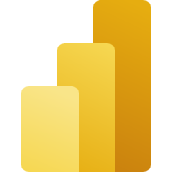


Data teams and Fabric
Fabric's unified management and governance make it easier for data professionals to work together.
Data Engineers
Data Scientists
Data Analysts
Decision Makers
Data Factory
Data Warehouse
Data Science
Azure ML
Data Warehouse
Real-time analytics
Power BI
Power BI
Microsoft 365
Data Engineering
Real-time analytics
Data Stewards
Notes:
Microsoft Fabric's unified management and governance make it easier for data professionals to work together on data projects. Fabric removes data silos and the need for access to multiple systems, enhancing collaboration between data professionals.

Slide 9
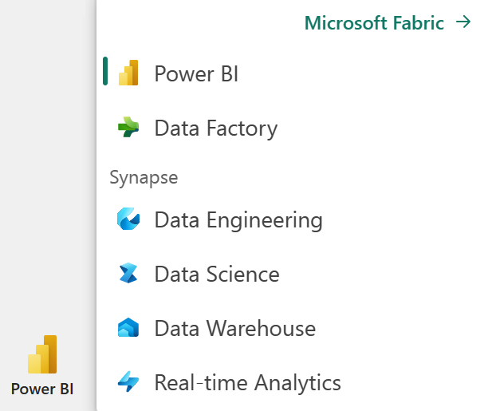
Enable and use Microsoft Fabric
Fabric must be enabled in your tenant by either:
Fabric admin (formerly known as Power BI admin)
Power Platform admin
Microsoft 365 admin
Workspace(s) must then be assigned to Premium per capacity or Fabric license mode.
Notes:
All Fabric items (lakehouses, notebooks, pipelines, etc.) are stored in OneLake and accessed via Fabric workspaces.

Slide 10

Knowledge check
Which of the following is a key benefit of using Microsoft Fabric in data projects?
It allows data professionals to work on data projects independently, without the need for collaboration.
It requires duplication of data across different systems and teams to ensure data availability.
It provides a single, integrated environment for data professionals and the business to collaborate on data projects.
How do compute engines in Fabric interact with data stored in OneLake?
Compute engines can directly access data in OneLake without the need for duplication or movement.
OneLake automatically converts data into csv format for seamless integration with compute engines.
Compute engines in Fabric can only interact with a limited subset of data formats within OneLake.
Which of the following Fabric experiences is used to move and transform data?
Data Science
Data Warehousing
Data Factory
Notes:
Allow students a few minutes to think about the questions, and then use the animated slide to reveal the correct answers.

Slide 11

Further reading
Introduction to end-to-end analytics using Microsoft Fabric
https://aka.ms/fabric-intro
Notes:
Encourage students to review the online material on Microsoft Learn on which this presentation is based.

Slide 12

Get started with lakehouses in Microsoft Fabric
Notes:
https://aka.ms/fabric-lakehouse Before delivering this section, review the associated module on Microsoft Learn (https://aka.ms/fabric-lakehouse).
The goal of this presentation is to provide an introduction to lakehouses, both conceptually and as they are implemented in Microsoft Fabric.
The estimated time to present these slides is 30 minutes.

Slide 13
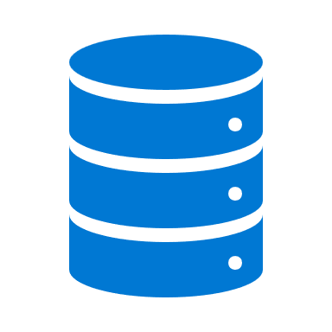

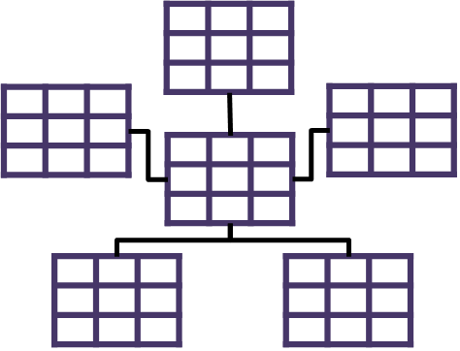

What is a lakehouse?
Data Lake
Data Warehouse
Scalable, distributed file storage​
Flexible schema-on-read semantics​
Big data technology compatibility​
Relational schema modeling​
SQL-based querying​
Proven basis for reporting and analytics​
Notes:
This is a build slide.
The foundation of Microsoft Fabric is a Lakehouse, which is built on top of the OneLake scalable storage layer and uses Apache Spark and SQL compute engines for big data processing. Click for descriptions.
A Lakehouse is a unified platform that combines:
The flexible and scalable storage of a data lake
The ability to query and analyze data of a data warehouse
A Lakehouse presents as a database and is built on top of a data lake using Delta format tables. Lakehouses combine the SQL-based analytical capabilities of a relational data warehouse and the flexibility and scalability of a data lake. Lakehouses store all data formats and can be used with various analytics tools and programming languages. As cloud-based solutions, lakehouses can scale automatically and provide high availability and disaster recovery. Benefits of a lakehouse:
- Utilizes Spark and SQL engines for large-scale data processing and analytics, including machine learning and predictive modeling.
- Adopts a schema-on-read format, allowing flexible schema definition as needed, rather than relying on a predefined schema.
- Supports ACID transactions through Delta Lake formatted tables, ensuring data consistency and integrity.
- Provides a centralized location for data engineers, data scientists, and data analysts to access and utilize data.

Slide 14

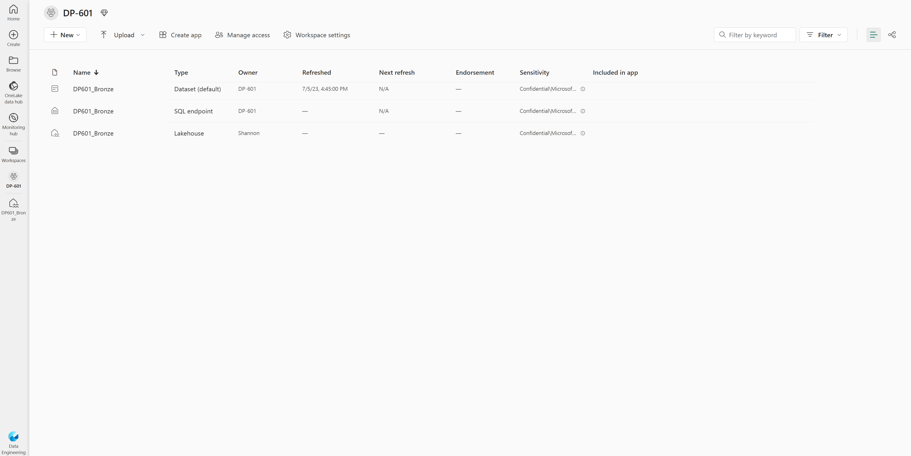
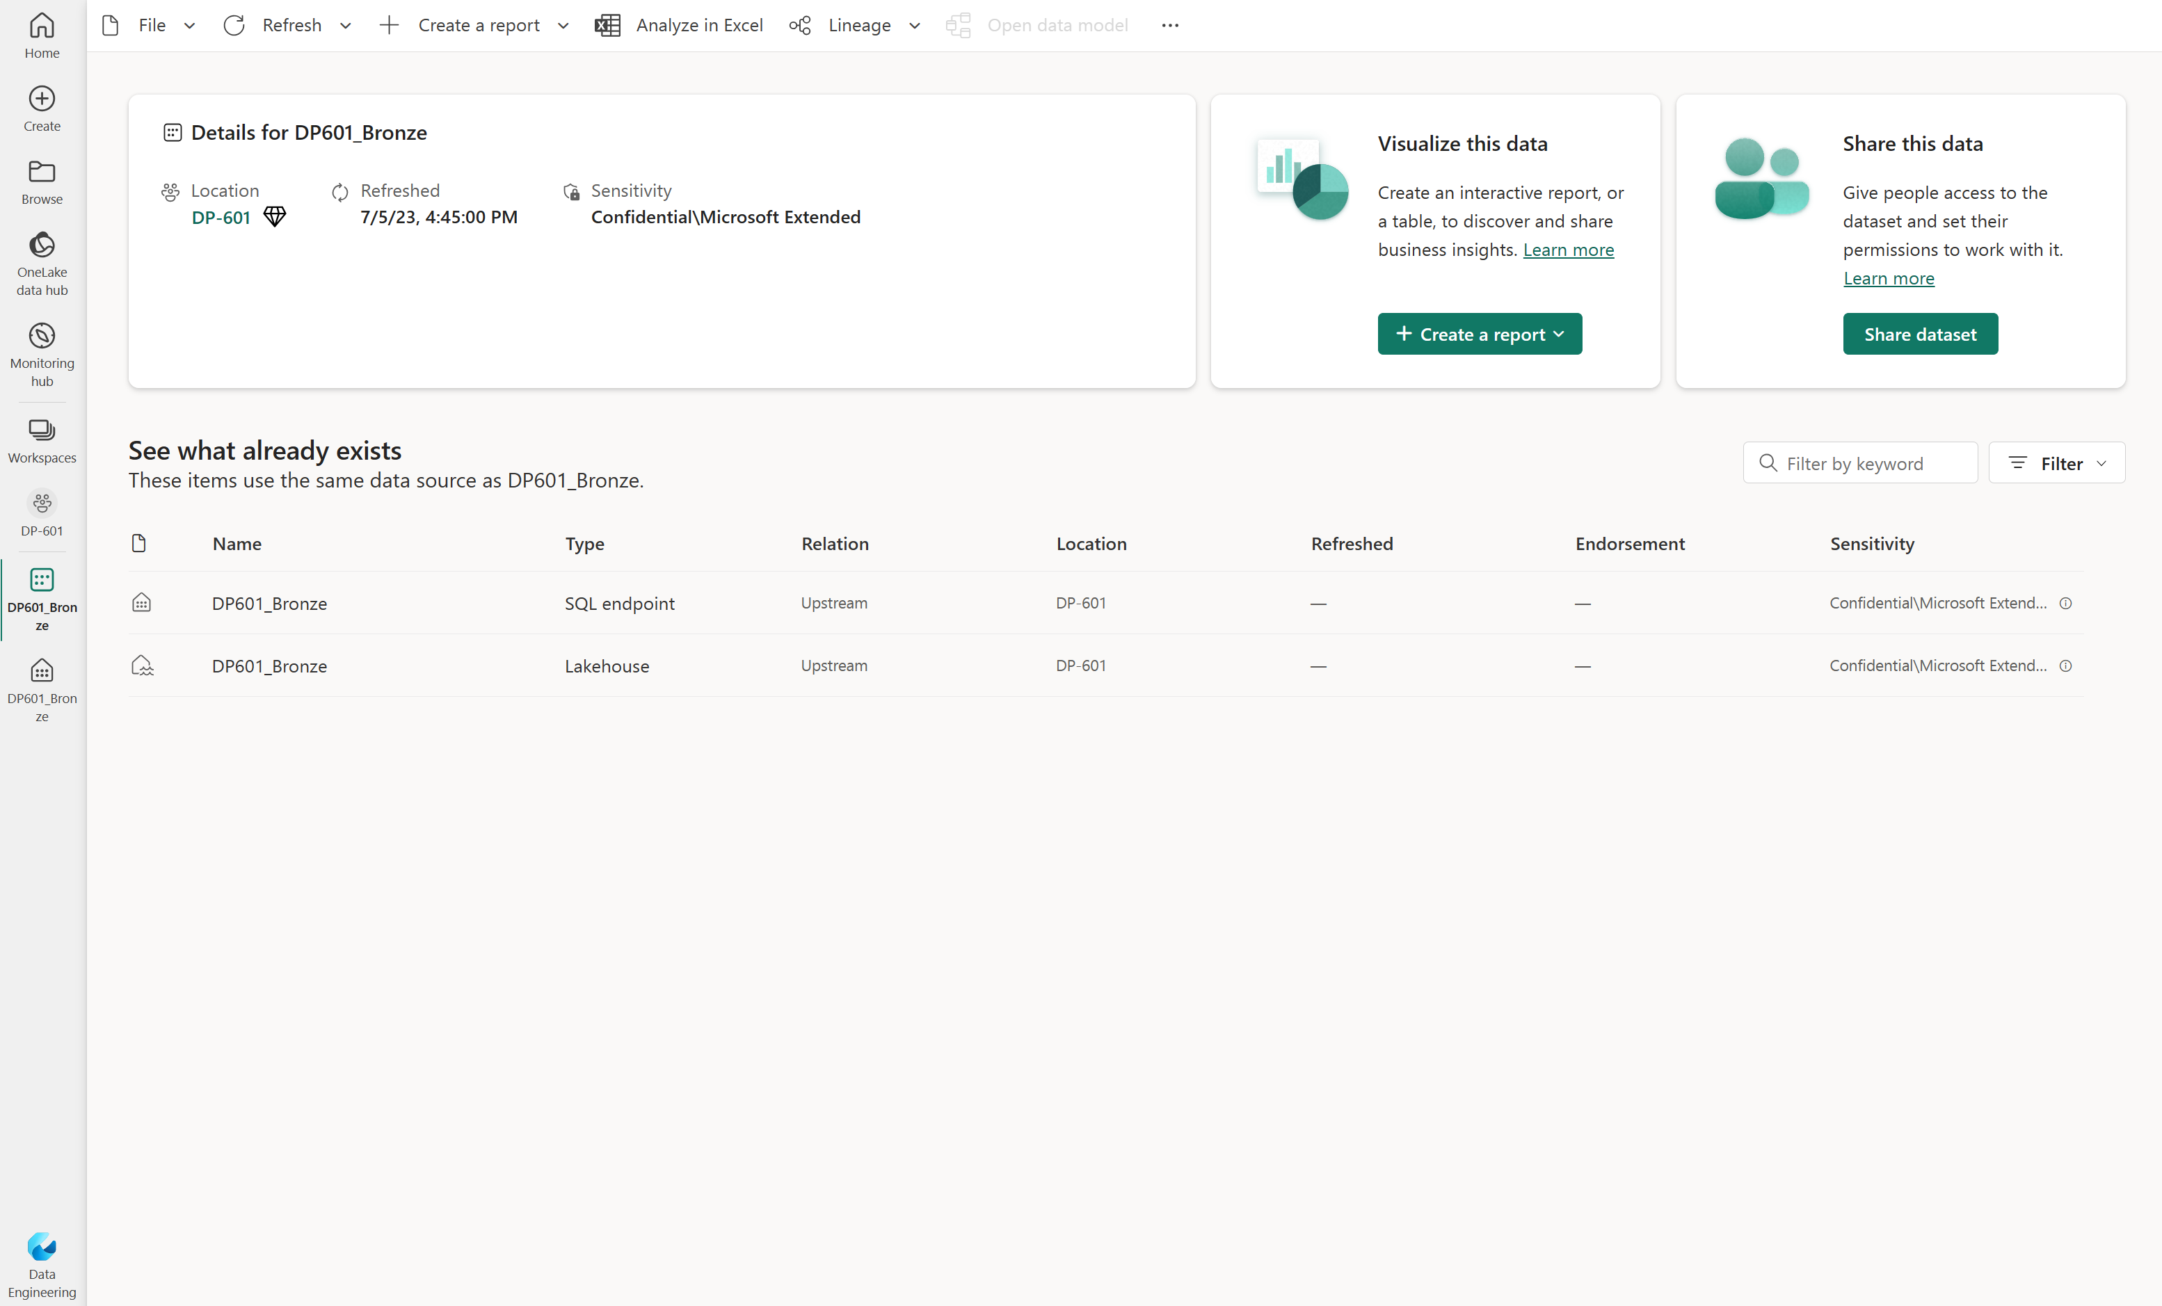
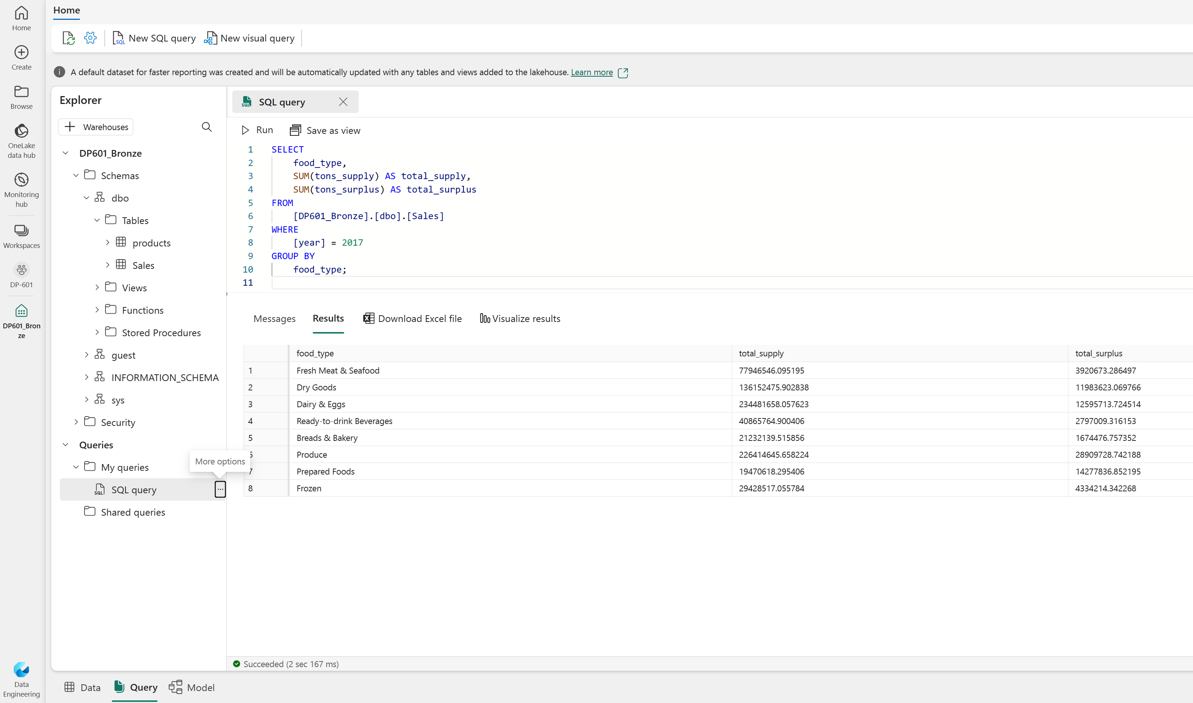
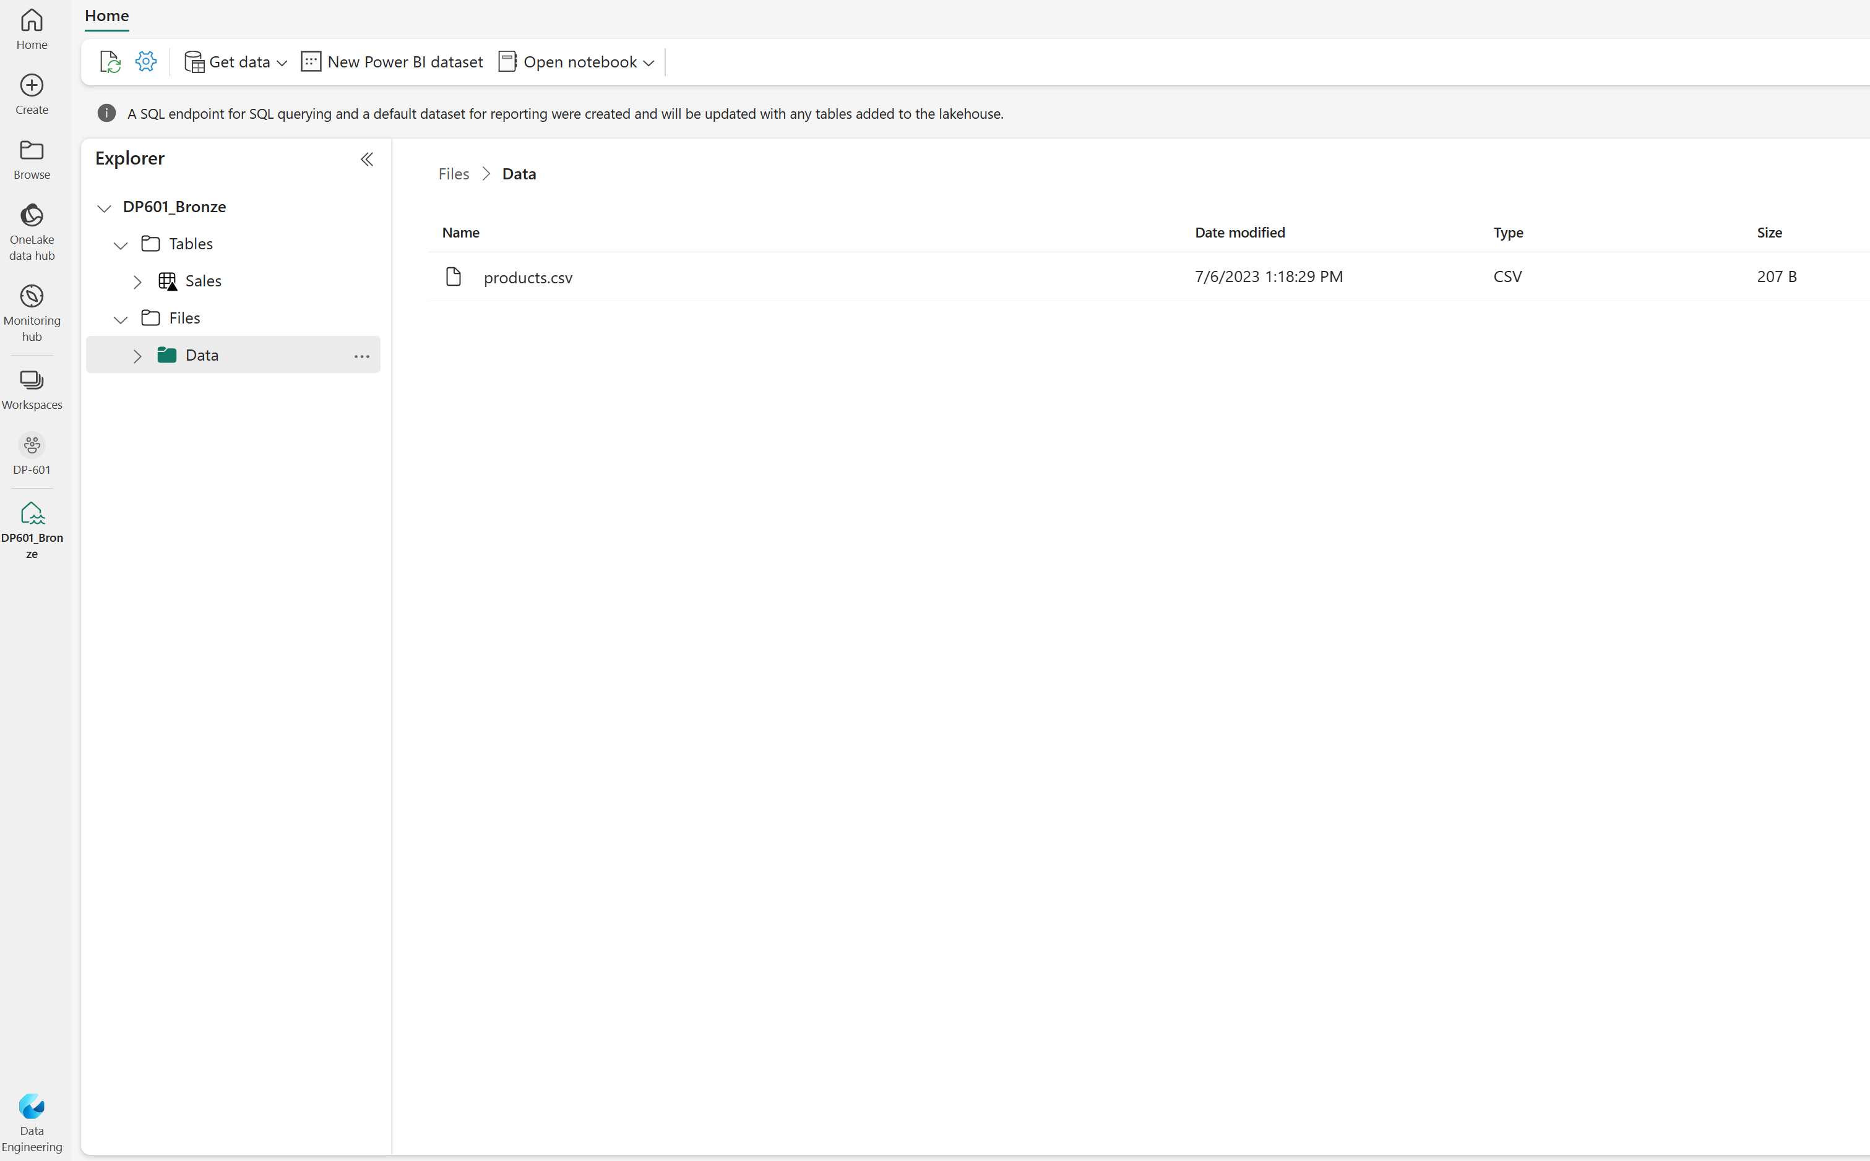
Work with a Fabric Lakehouse
Notes:
This is a build slide.
In Microsoft Fabric, you can create a lakehouse in the Data engineering experience in any premium tier workspace. After creating a lakehouse, you can load data - in any common format - from various sources; including local files, databases, or APIs.
Lakehouses are created and configured in the Data Engineering experience. Click to see the Fabric items that are created when you create a lakehouse. The creation of a single lakehouse produces three named items in the Fabric-enabled workspace:
Lakehouse is the lakehouse storage and metadata, where you interact with files, folders, and table data.
A dataset (default) is an automatically created data model based on the tables in the lakehouse. Power BI reports can be built from the dataset.
The SQL Endpoint is a read-only SQL endpoint through which you can connect and query data with Transact-SQL.

Slide 15






Explore, transform, and visualize data in the lakehouse
Tools and techniques to explore and transform data:
Apache Spark
Notebooks
Spark Job Definitions
SQL Endpoint
Dataflows (Gen2)
Data Pipelines
Visualize lakehouse data using Power BI
Notes:
After loading data into the lakehouse, you can use various tools and techniques to explore and transform it, including:
Apache Spark: Each Fabric lakehouse can use Spark pools through Notebooks or Spark Job Definitions to process data in files and tables in the lakehouse using Scala, PySpark, or Spark SQL.
Notebooks: Interactive coding interfaces in which you can use code to read, transform, and write data directly to the lakehouse as tables and/or files.
Spark Job Definitions: On-demand or scheduled scripts that use the Spark engine to process data in the lakehouse.
SQL Endpoint: Each lakehouse includes a SQL endpoint through which you can run Transact-SQL statements to query, filter, aggregate, and otherwise explore data in lakehouse tables.
Dataflows (Gen2): In addition to using a dataflow to ingest data into the lakehouse, you can create a dataflow to perform subsequent transformations through Power Query, and optionally land transformed data back to the Lakehouse.
Data Pipelines: Orchestrate complex data transformation logic that operates on data in the lakehouse through a sequence of activities (such as dataflows, Spark jobs, and other control flow logic).

Slide 16
Exercise
Create and ingest data with a Microsoft Fabric Lakehouse
Notes:
https://aka.ms/mslearn-fabric-lakehouse The estimated time to complete this exercise is 30 minutes.

Slide 17
Knowledge check
What is a Microsoft Fabric Lakehouse?
A relational database based on the Microsoft SQL Server database engine.
A hierarchy of folders and files in Azure Data Lake Store Gen2.
An analytical store that combines the file storage flexibility of a data lake with the SQL-based query capabilities of a data warehouse..
You want to include data in an external Azure Data Lake Store Gen2 location in your lakehouse, without the requirement to copy the data. What should you do?
Create a Data pipeline that uses a Copy Data activity to load the external data into a file.
Create a shortcut.
Create a Dataflow (Gen2) that extracts the data and loads it into a table.
You want to use Apache Spark to interactively explore data in a file in the lakehouse. What should you do?
Create a notebook.
Switch to the SQL Endpoint mode.
Create a Dataflow (Gen2).
Notes:
Allow students a few minutes to think about the questions, and then use the animated slide to reveal the correct answers.

Slide 18
Further reading
Get started with lakehouses in Microsoft Fabric
https://aka.ms/fabric-lakehouse
Notes:
Encourage students to review the online material on Microsoft Learn on which this presentation is based.

